Slide 1
THE DOME – IN FRP
THE ULTIMATE LIGHTWEIGHT SOLUTION
GFRC FACADES
MUMBAI

Slide 2
FRP DETAILS &
FACTS ON THE PROJECT
FRP IS A VERY VERSITILE LOW WEIGHT MATERIAL FOR EXTERIOR DOMES AS IT PROVIDES A SEAMLESS FINISH , LOW WEIGHT TO STEEL FRAMEWORK & LIFE
FRP MANUFACTURING IS INDEED A LABOUROUS PROCESS WHEREIN
A LAYER OF GEL COAT IS APPLIED ONTO THE FACE OF THE MOLD AND THE A LAYER OF FIBRE MAT AND SO ON TO ACHIEVE THE DESIRED THICKNESS
THE THICKNESS OF THIS FRP MODULE BEING 8MM & ITS WEIGHT BEING 11 KGS PER SQM, WHEREAS IF CONISDERED IN GRC THE WEIGHT WOULD BE OVER 55 KGS PER SQM FOR A THICKNESS OF 20MM.
FR FRP GRADE ALSO AVAILABLE WHERE SUCH RARINGS ARE ESSENTIAL
UV RESISTANT RESIGN ASSO AVAILABLE ON REQUEST
A PROPOTIONAUE WEIGHT OF STEEL IS TO BE CONSIDERED IN USING THE TWO DIFFERENT ELEMENTS FRP / GRC, AND THE RATIO OF STEEL REQUIRED IS APPROXIMATELY - 1: 4

Slide 3
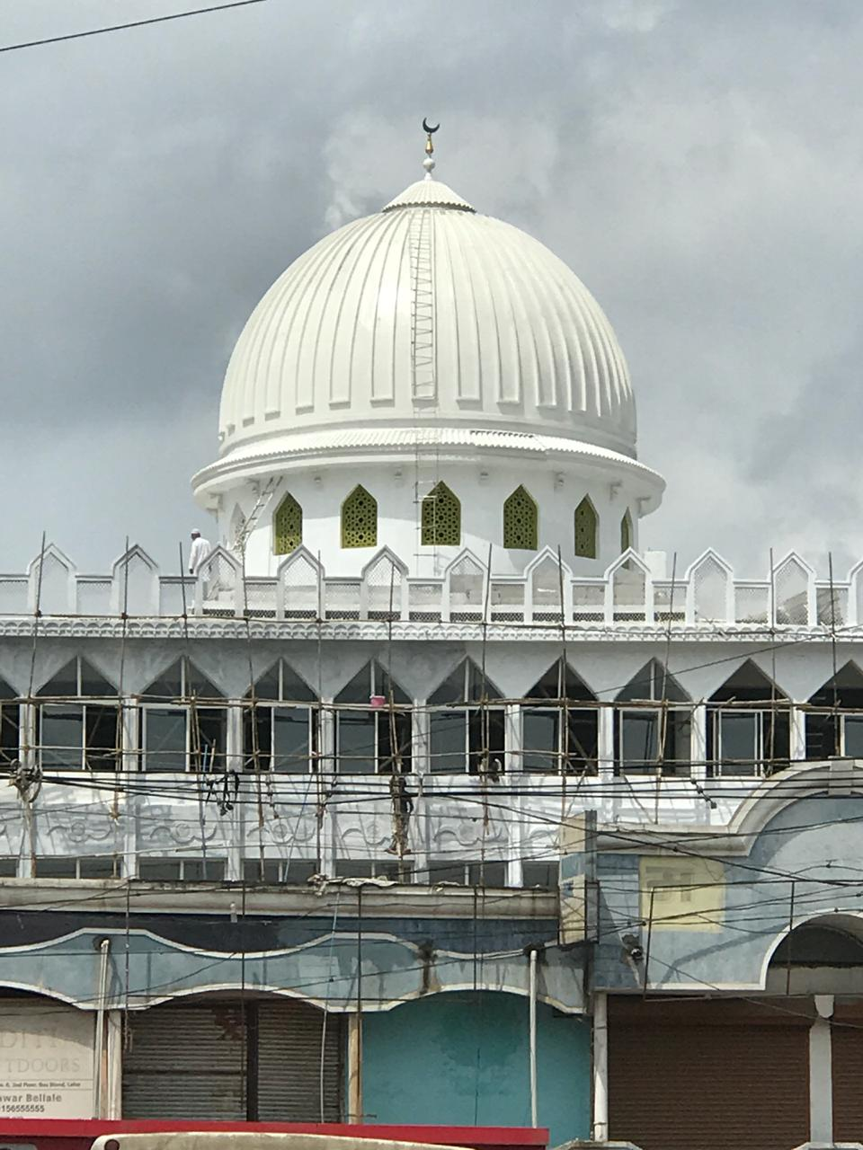
FRP IS A VERY VERSITILE LOW WEIGHT MATERIAL FOR EXTERIOR DOMES AS IT PROVIDES A SEAMLESS FINISH , LOW WEIGHT TO STEEL FRAMEWORK & LIFE

Slide 4
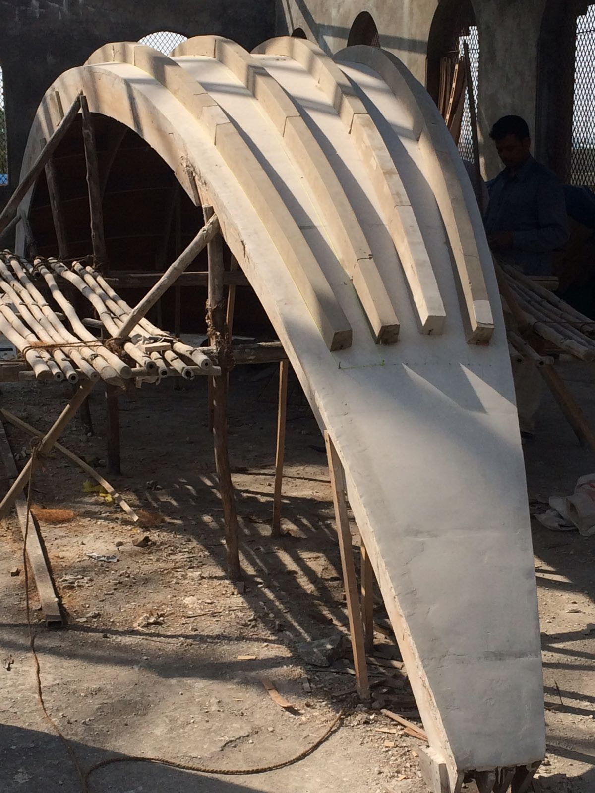
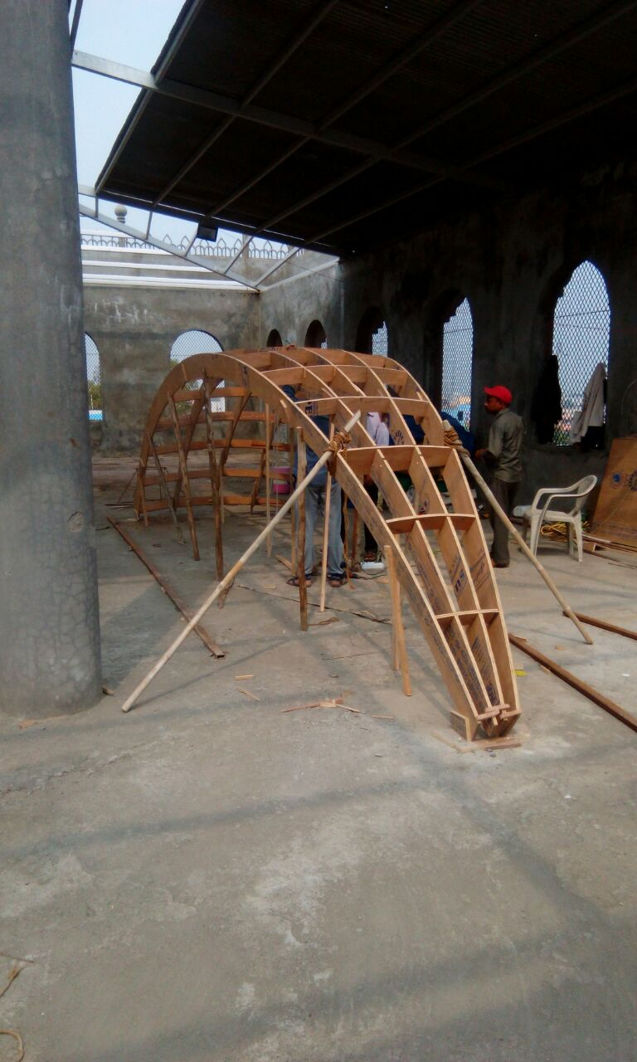
THE MOLD AND ITS FRAMEWORK
THE MOLD - 1/16 PART
THE FRAME WORK

Slide 5
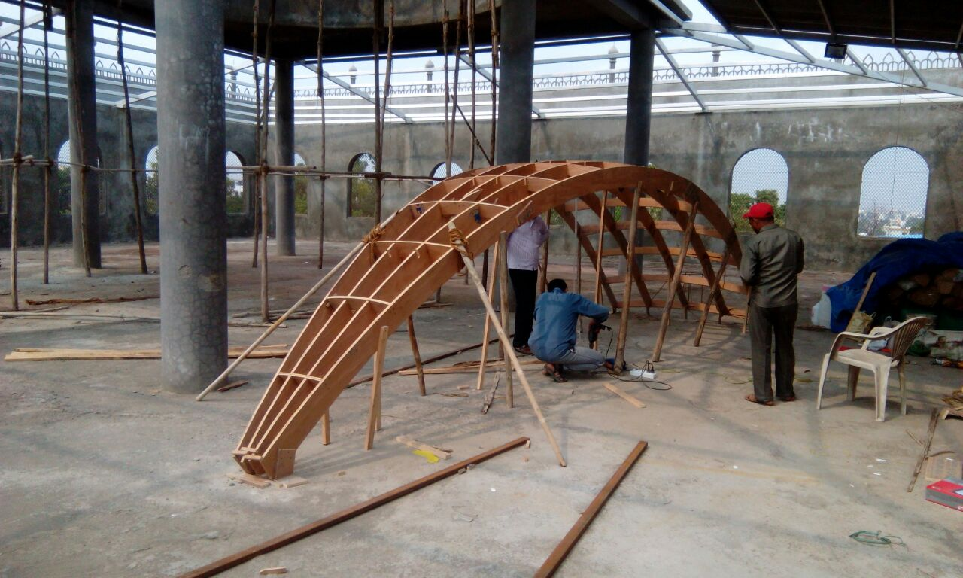
THE PROFILE OF THE DOME

Slide 6
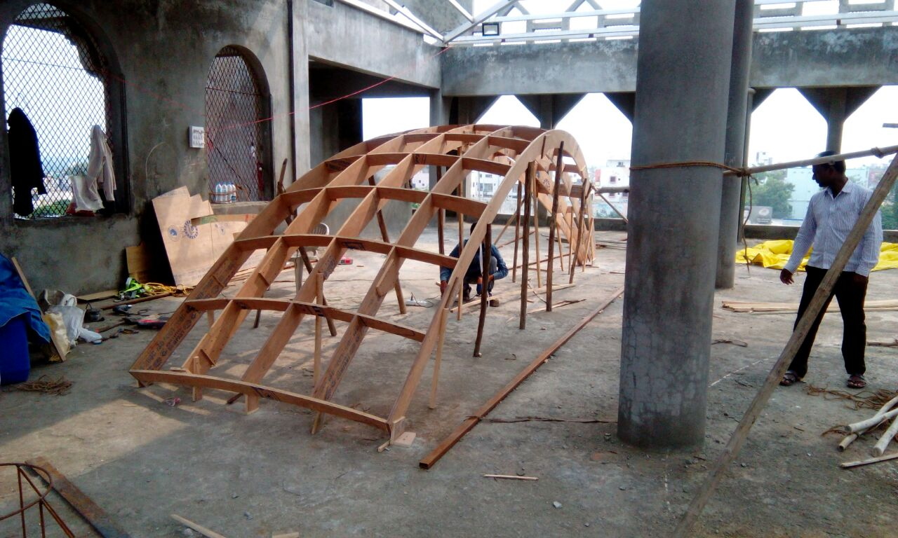
THE PROFILE OF THE DOME

Slide 7
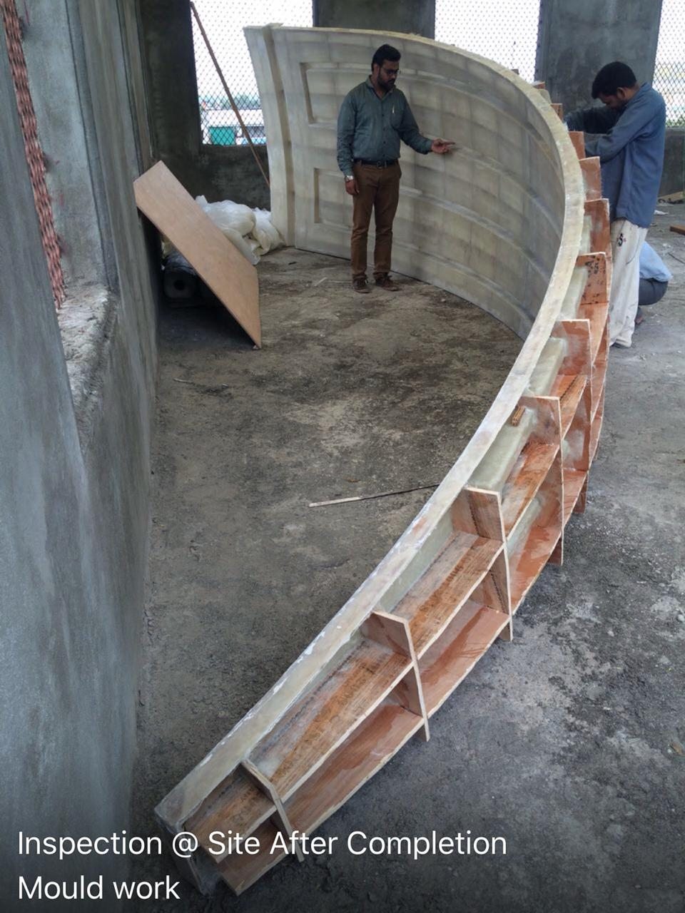
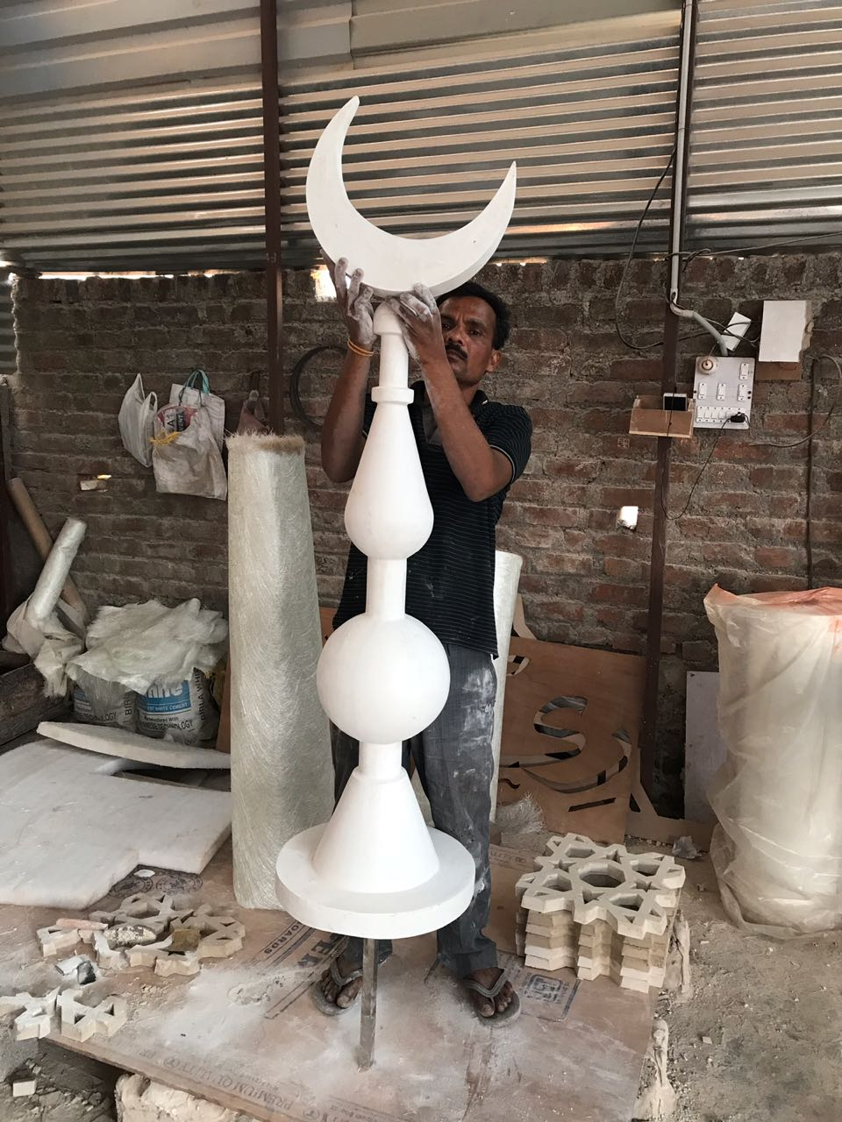
THE MOLD AND THE DOME CREST
THE

Slide 8
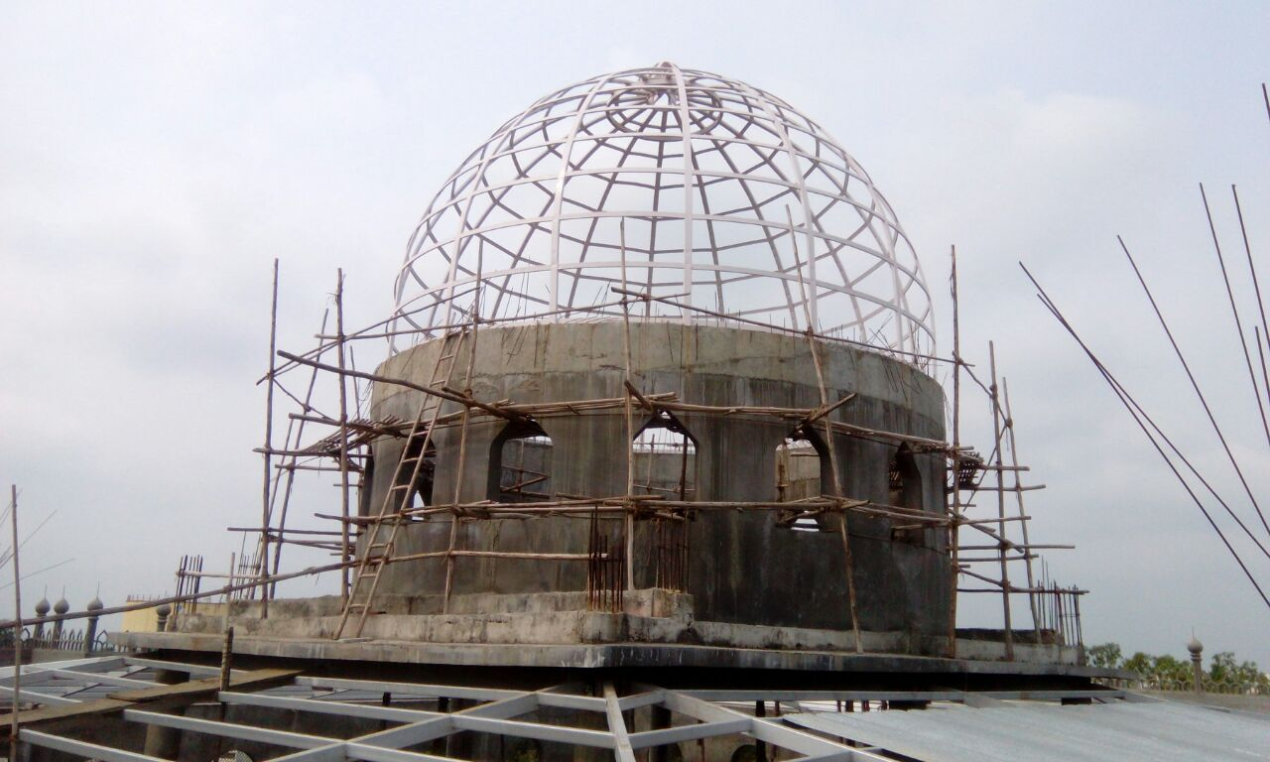
THE MS STEEL FRAMEWORK
THE REQUIREMENT OF STEEL ON A FRP MODULE REQUIRED IS VERY LESS UNLIKE THAT REQUIRED FOR GRC.

Slide 9
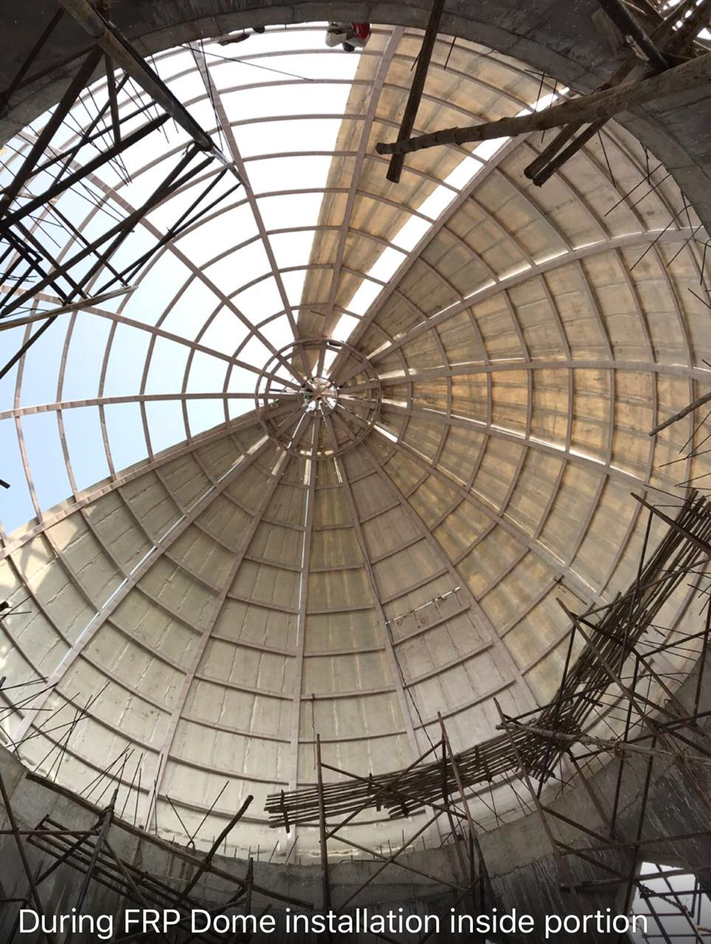
THE STEEL FRAME – INSIDE VIEW

Slide 10
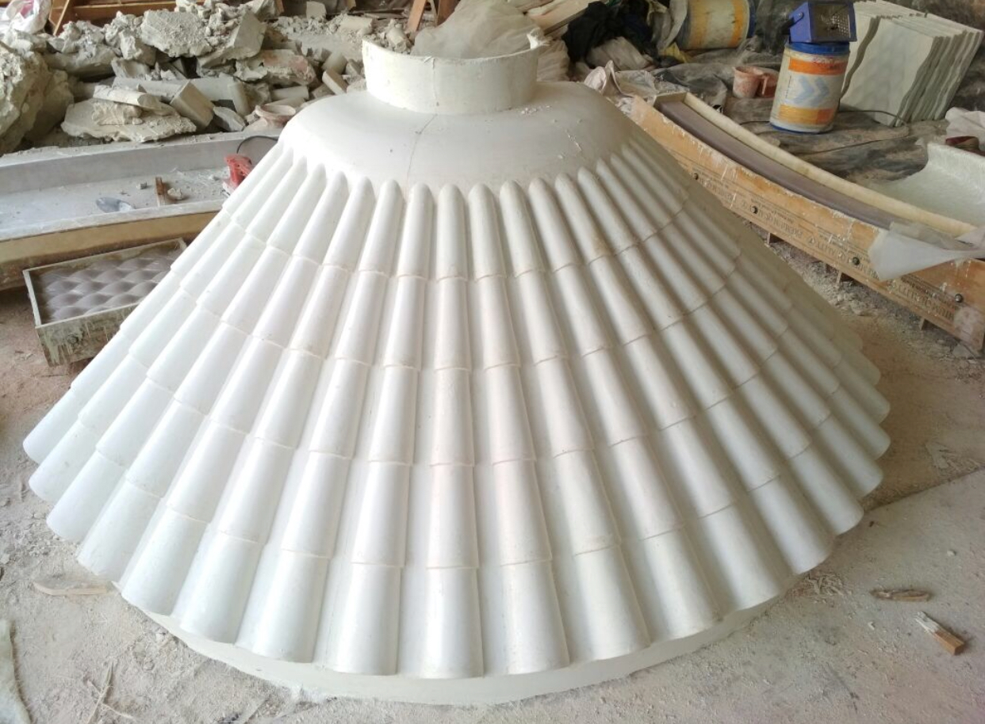
THE TOP END DECORATIVE CONNECTOR
ON THE TOP SIDE WHERE ALL THE 16 PARTS MEET, THIS ELEMENT IS PLACED OVER IT TO PROVIDE BETTER AESTHETICS & UTILITY.

Slide 11
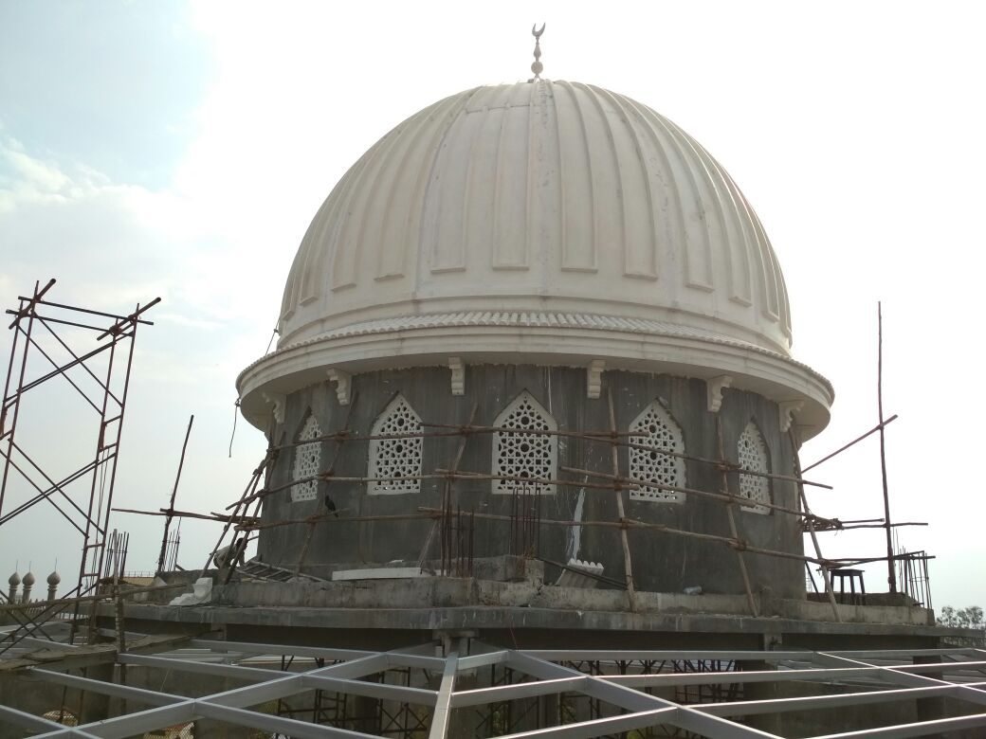
DOME – FINISHING WORKS

Slide 12
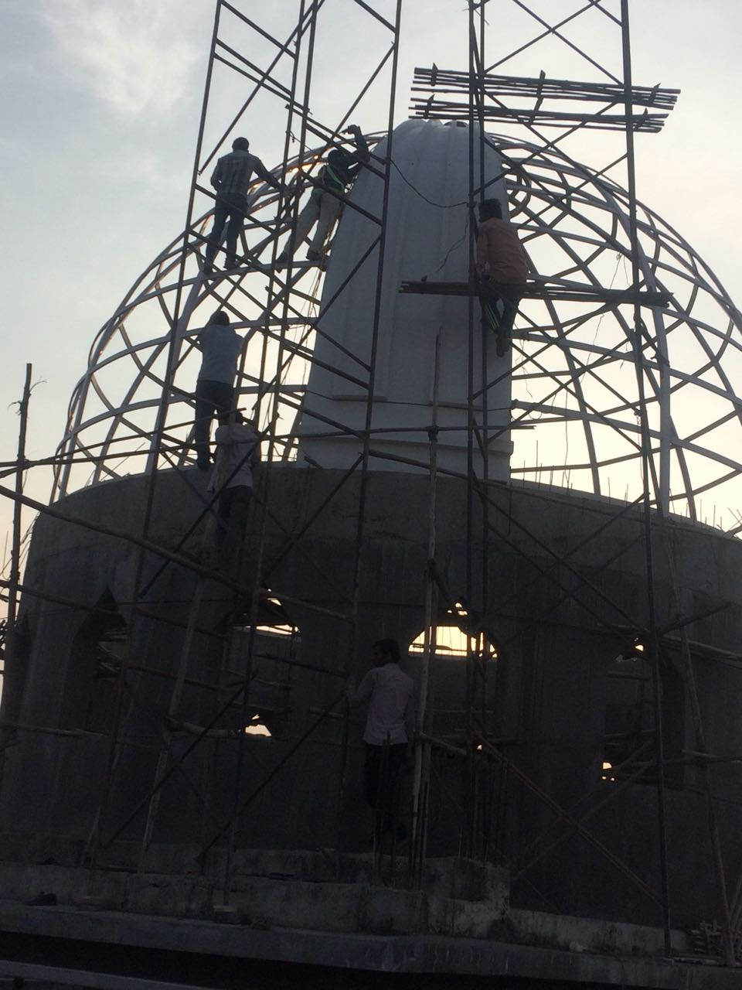
ONE PART OF THE 16 PIECES BEING INSTALLED
THE THICKNESS OF THE FRP MODULE IS 8MM THICK TO FACTOR ALL REQUIRED TECHNIAL PARAMETERS.

Slide 13
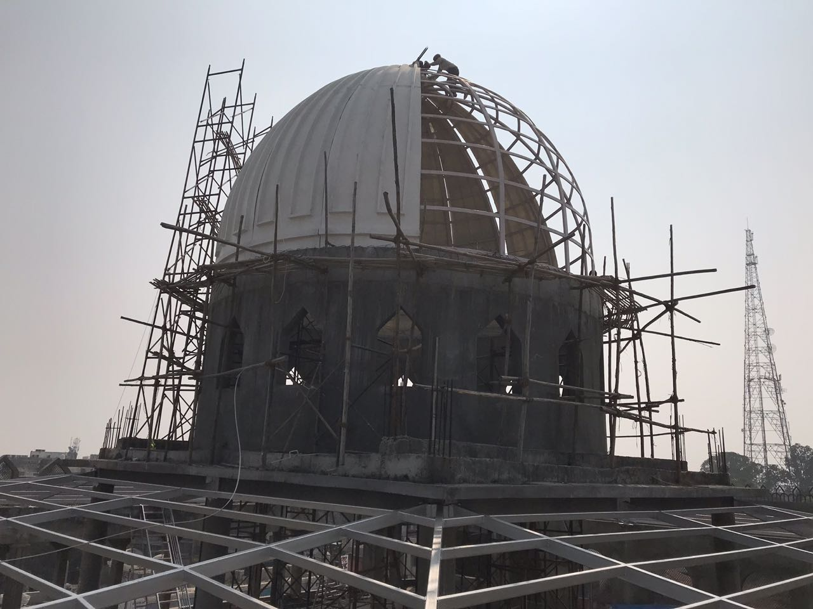
INSTALLATION WORK IN PROGRESS

Slide 14
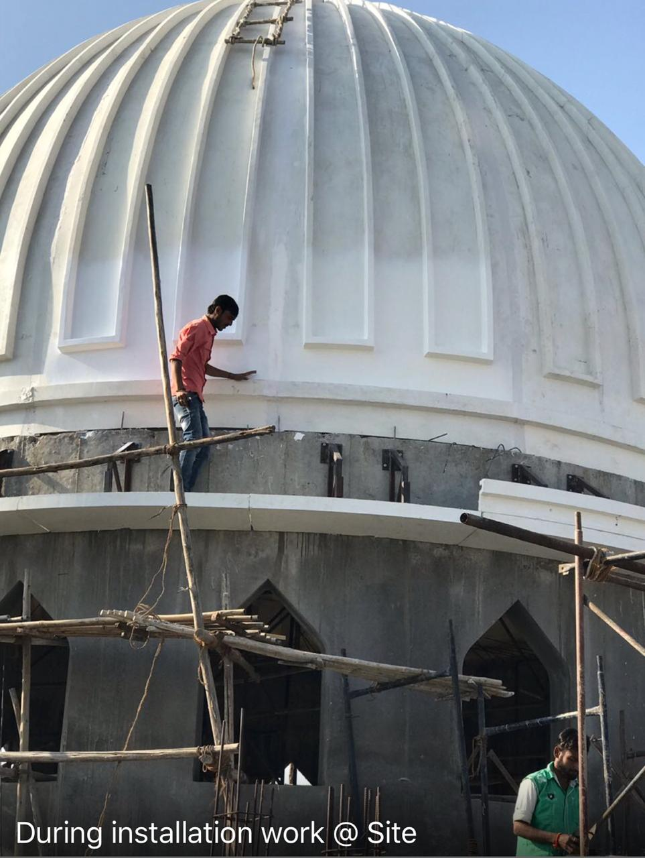
FINISHING OF THE JOINTS

Slide 15
CONTACT DETAILS
GFRC FACADES.
GFRC / GRC, GRG CEILINGS & PANELS, FRP WORKS, HIGH END DECORATIVE & ARCHITECTURAL WORKS & ACOUSTIC SOLUTIONS WITH EXPERTISE IN HOME THEATRES
SRIHARI NILKAR
MUMBAI
Mobile: 09867569395
nilkarsrihari@gmail.com

